Slide 1
How to Remap a Network Drive

Slide 2
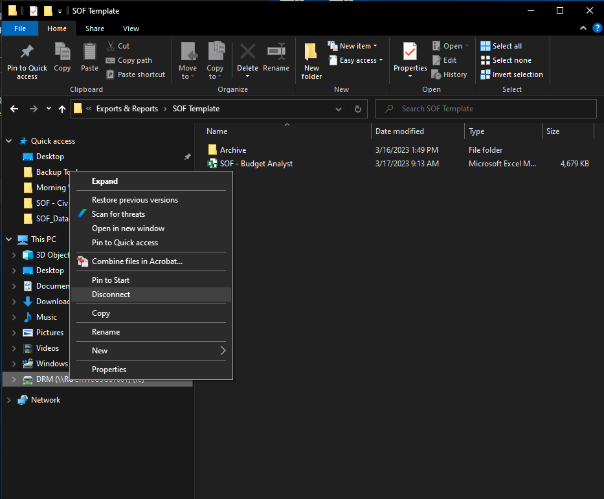
Right click on your current R:/ drive and select “Disconnect”

Slide 3
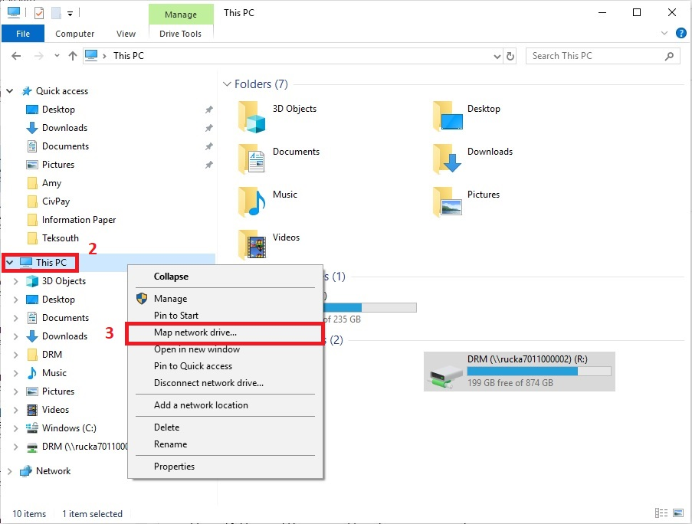
Note: If you are teleworking, make sure you are connected to the VPN before starting.
1. Open a Windows file explorer. Make sure you do not have the R drive or any files from the R drive open.
2. On the left side of the window, right-click “This PC” which will open a small menu
3. Click on “Map network drive…” which will open another window

Slide 4
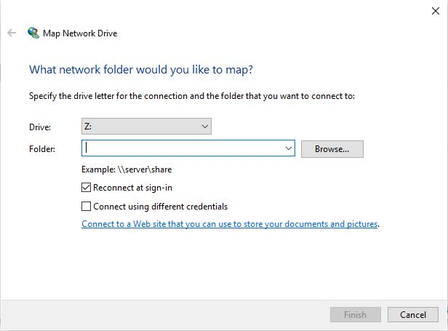
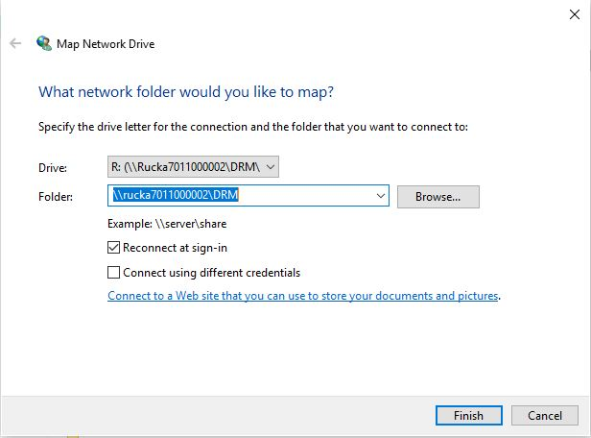
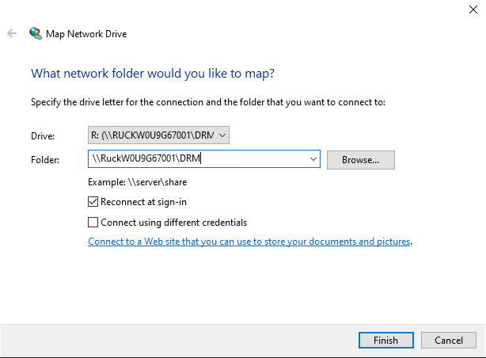
4. Fill in the information in the second picture below
- Drive = R:
- Folder = \\RUCKW0U9G67001\DRM
- Keep the check boxes as is
5. Click Finish and two message boxes will popup (see step 6)

Slide 5
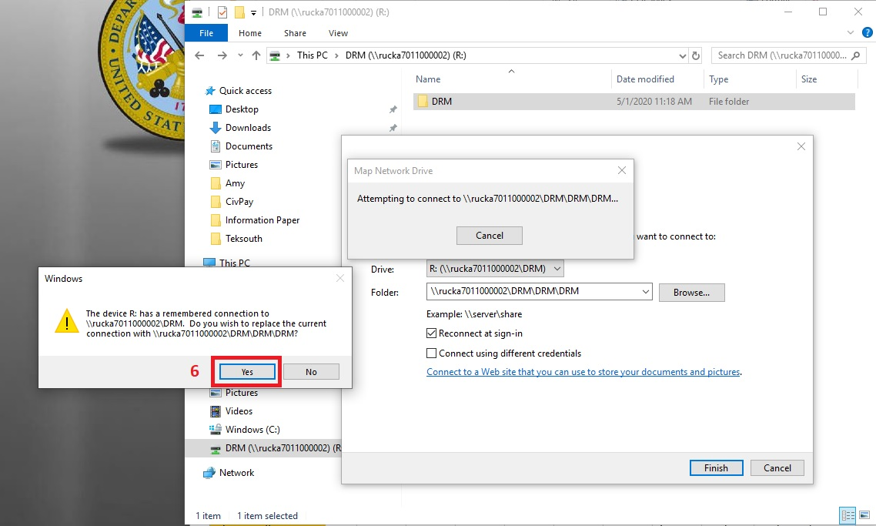
6. Click “Yes” on the message box that asks if you want to replace the current connect
You should now be able to access the R drive as normal (without the extra DRM folders).

